Slide 1




DIGITAL LITERACY
SKILLS
INTERMEDIATE USERS

Slide 2

Module 2
Information processing

Slide 3

1
Unit 1: Browsing, searching and filtering data, information and digital content

Slide 4

Main concepts: IT, ICT, and Internet
IT (Information Technology): The hardware (all devices or machines), software (computer programs), and computer networks (computers connected to each other).
ICT (Information and Communication Technology): The transfer and use of information using IT.
The internet: The global system made up of interconnected computers and computer.

Slide 5
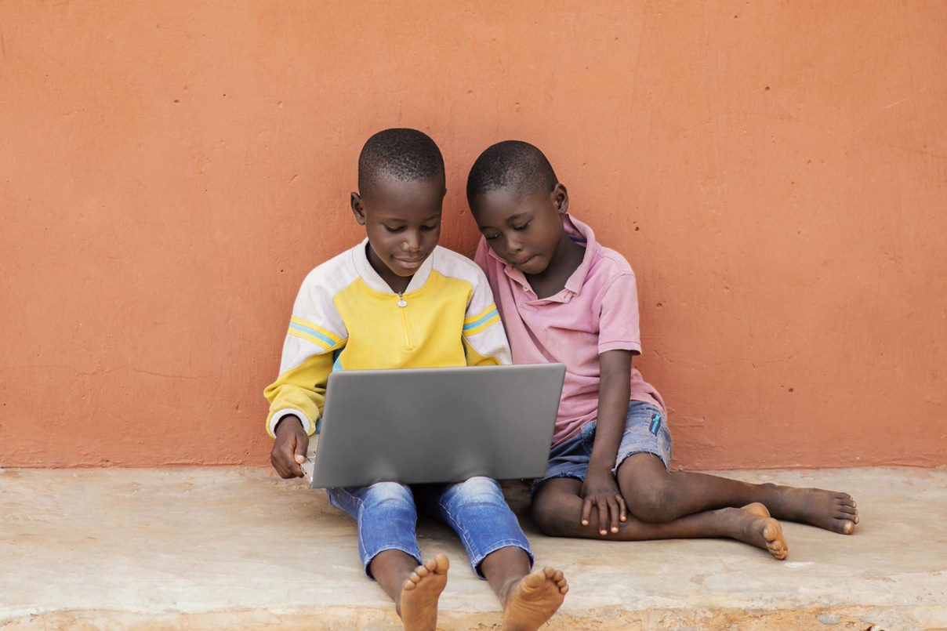
Searching online
Search engine: Specialised website that searches for information across the internet.
Search terms: The words or phrases that you use to search for information online.
Search results: A list of websites, or photos or videos, that a search engine shows you when you search.

Slide 6
How to start searching
1
2
3
To start a search, click on a browser, such as Edge, Firefox, or Chrome.
Go to the search engine's homepage and type your search terms into the text box.
To see your results, press Enter, or you can click an icon, such as the Google Search button or a magnifying glass.

Slide 7

Search strategies
Keep it simple: A simple search term is better for getting specific results. For example: beans recipe.
Consider suggestions: As you type, the search engine may give you suggestions. These can be useful and improve the quality of your results.
Use natural language: You can type questions directly into a search engine, for example: “What do cats eat” or “Directions from X to X”

Slide 8
Skills to practise
Identify key words for a search. Practice writing the most effective key words for a search, e.g., African teams results from the 2022 Football World Cup key words – African teams results 2022 World Cup
Search using more than one search engine. For example, use Firefox and Google to search with the same key words and compare the results.
Use a filter to refine your search. Using the same key words, filter your search by clicking on All, News, Videos or Images. Notice the different results.
Identify one suitable website that provides the best result from your search.

Slide 9
All back covers should include
contact information of the section
producing the work.
© United Nations Children’s Fund (UNICEF) [month and year of publication]

